Slide 1
On the Traffic Light Timing Setting Problem
Chang-Biau Yang and Yun-Jaw Yeh
Presented by Jian-Fu Dong

Slide 2
Abstract(1/2)
This paper studies the traffic light timing setting problem. The traffic network of a city can be modeled by a graph in which vertices represent the intersections of roads and edges represent the segments of roads. The traffic light problem is concerned with the setting of the starting time of the green light for each traffic light such that the total waiting time of the traffic in the traffic network is minimized. We consider two versions of the traffic light problem: simplified and realistic. In the simplified version, there is only one traffic light on each vertex, while in the realistic version, the number of traffic lights on each vertex is equal to its degree.

Slide 3
Abstract(2/2)
In this paper, we first prove that the traffic light problem is NP-hard for the traffic light cycle T ≥ 3, that the traffic light problem on a planar graph with T = 2 can be solved by the algorithm designed for the weighted maximum cut problem, whose time complexity is O(n^{3/2} log n), and that the two-phase setting problem (a special case of the traffic light problem) on a planar graph can also be solved in the same time complexity. Then, we discuss some properties of the traffic light problem. Using these properties, we design an algorithm to find the minimum penalty of a polygon with n edges in O(n) time. Finally, we present a heuristic algorithm to solve the traffic light problem and show some experiment results

Slide 4
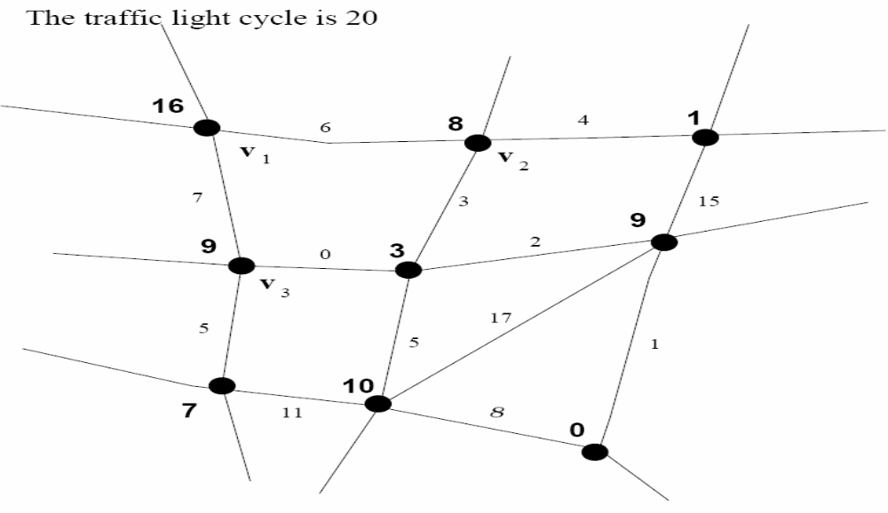
Graph of The Traffic Light Problem

Slide 5
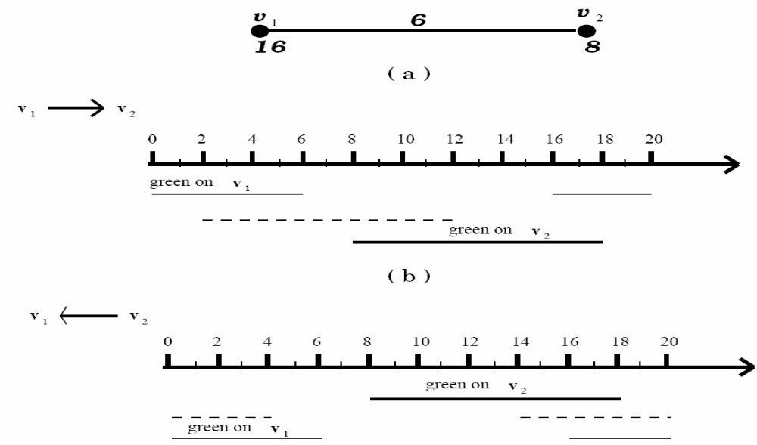
Penalty of an edge

Slide 6
The Definition of the Traffic Light Problem
Simplified :Given a traffic light cycle T (T is even) and a graph G = (V,E) in which each edge (u, v) is associated with a nonnegative integral distance d(u, v), we want to assign t(v) for each vertex v ∈ V such that the total penalty (Σ _{u∈V} Σ _{v∈V} P_{uv}) is minimized.

Slide 7
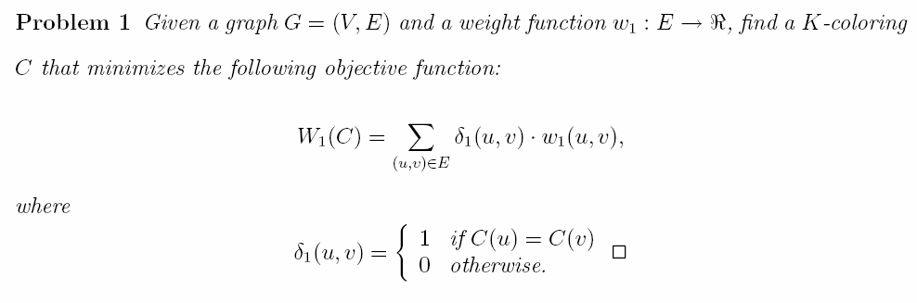
NP-Hardness of the Traffic Light Problem(1/3)

Slide 8
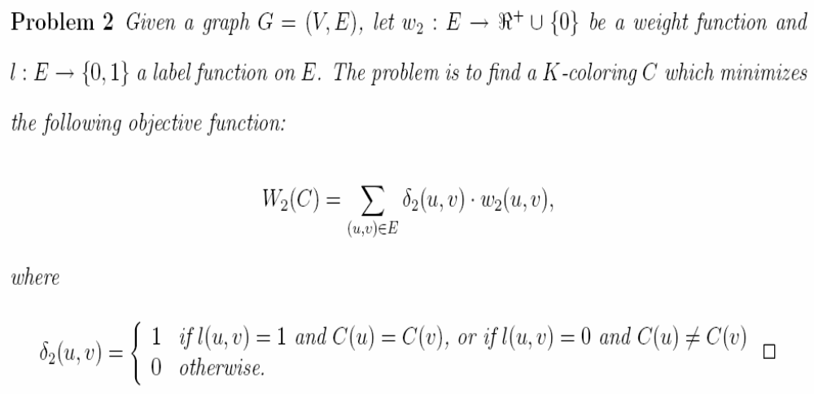
NP-Hardness of the Traffic Light Problem(2/3)

Slide 9
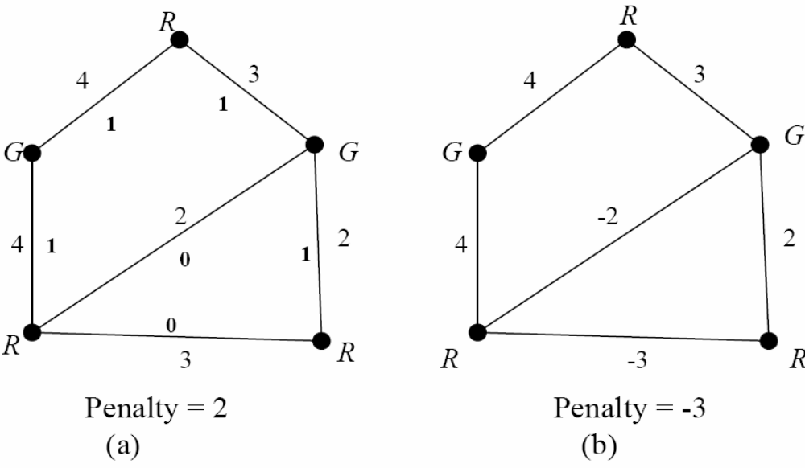
NP-Hardness of the Traffic Light Problem(3/3)

Slide 10

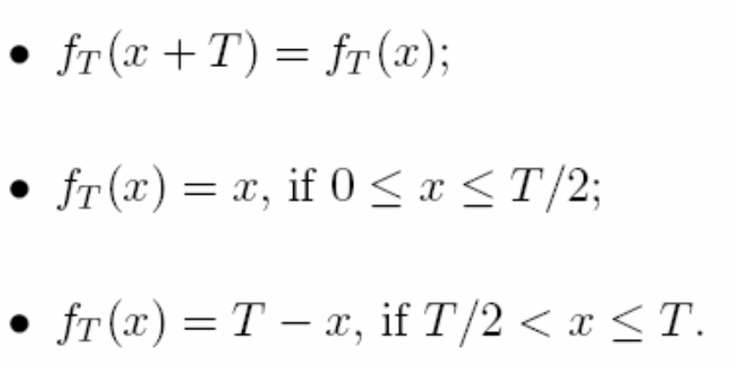



Properties of the Traffic Light Problem(1/2)

Slide 11

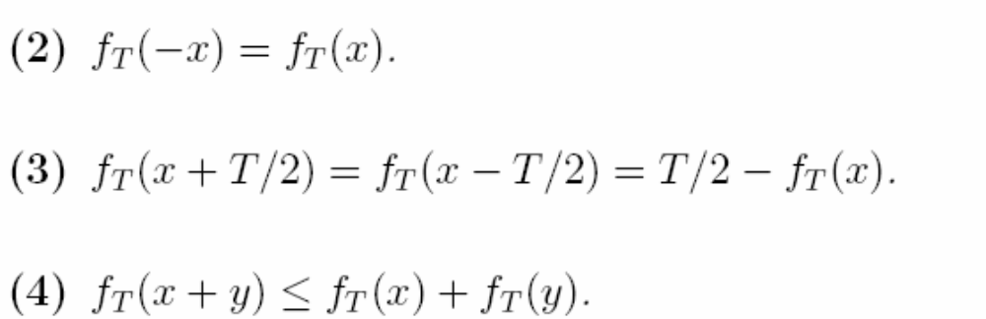
Properties of the Traffic Light Problem(2/2)

Slide 12
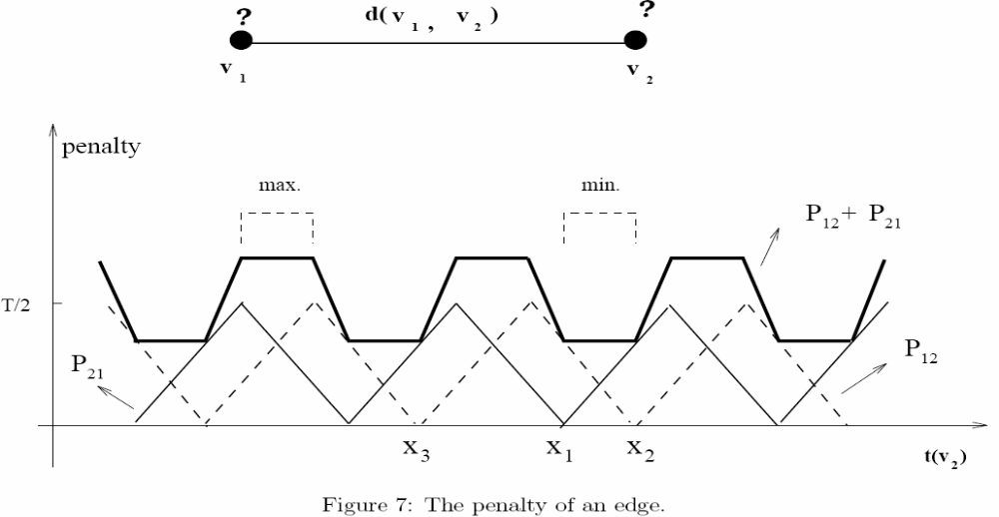
Minimum penalty of an edge(1/2)

Slide 13
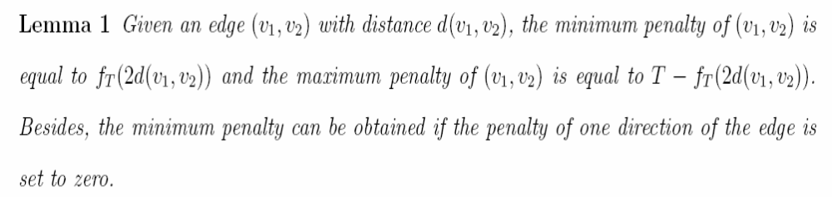
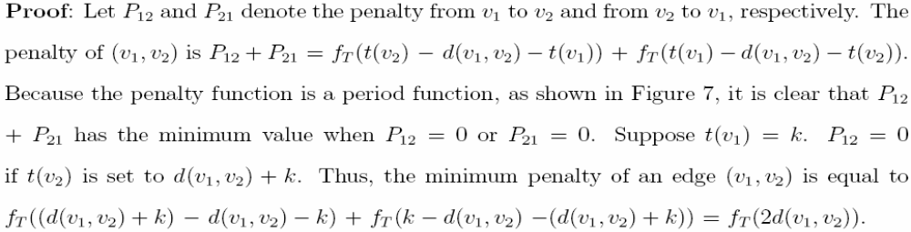
Minimum penalty of an edge(2/2)

Slide 14
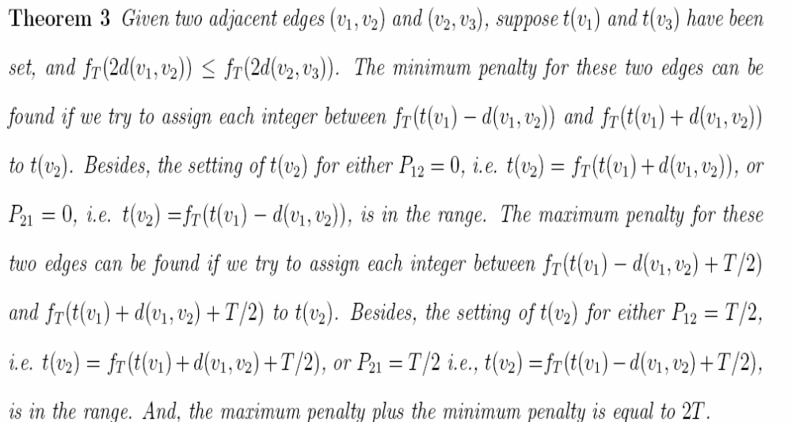
Minimum penalty of two adjacent edges(1/2)

Slide 15
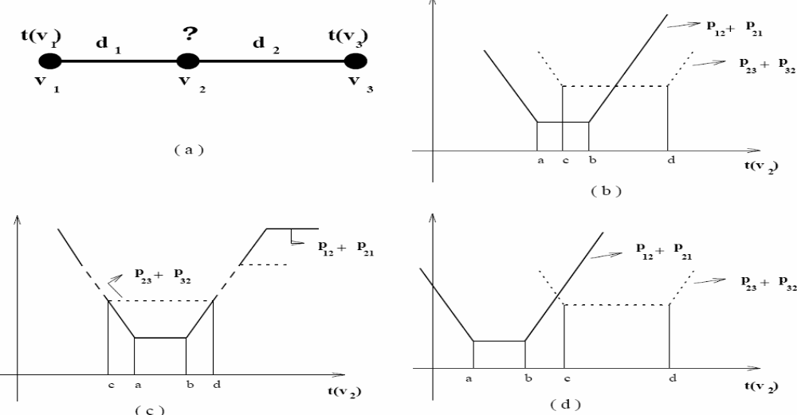
Minimum penalty of two adjacent edges(2/2)

Slide 16
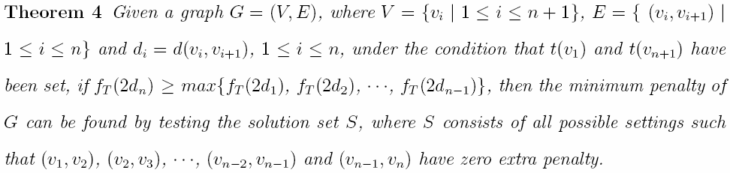
Minimum penalty of a path with n edges

Slide 17
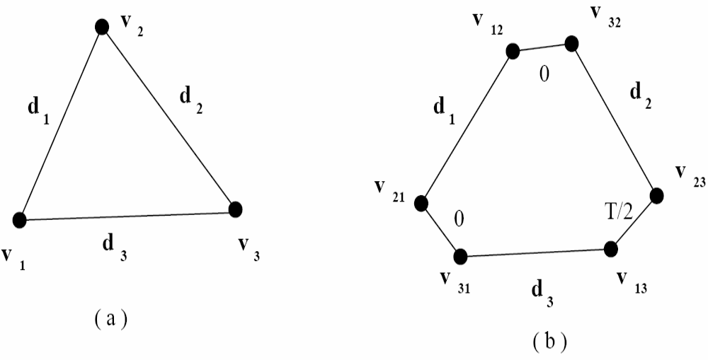
Realistic traffic light problem transformation

Slide 18
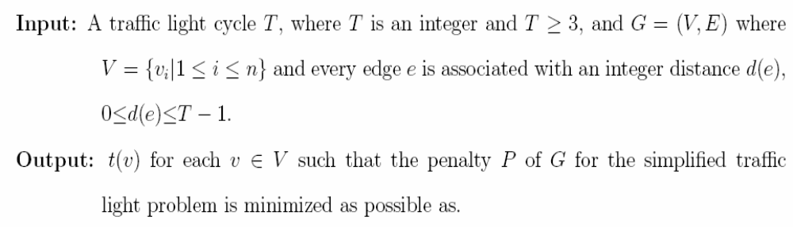
TIS Heuristic Algorithm(1/2)

Slide 19
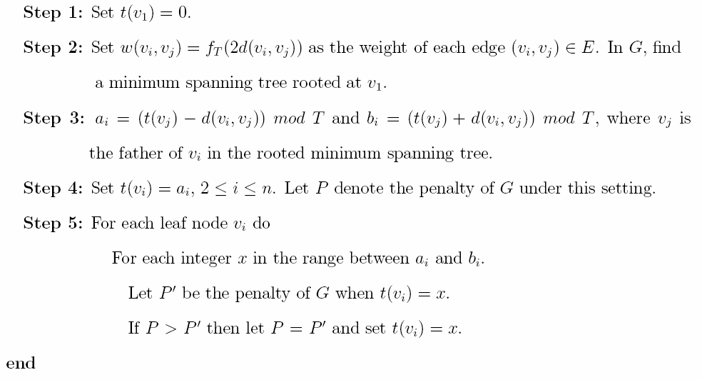
TIS Heuristic Algorithm(2/2)

Slide 20
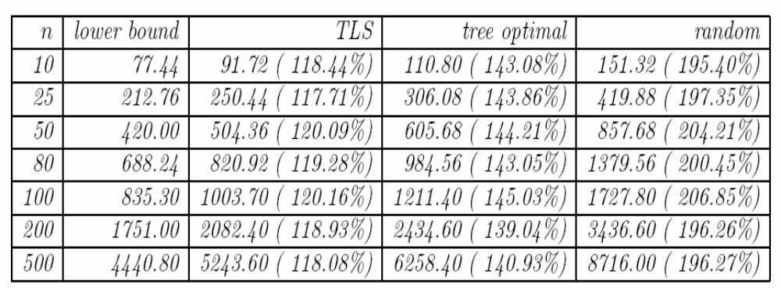
Result

